Slide 1
Tweety

Slide 2




01
02
03
04
标题数字等都可以通过点击和重新输入进行更改，顶部“开始”面板中可以对字体、字号、颜色、行距等进行修改。
标题数字等都可以通过点击和重新输入进行更改，顶部“开始”面板中可以对字体、字号、颜色、行距等进行修改。
标题数字等都可以通过点击和重新输入进行更改，顶部“开始”面板中可以对字体、字号、颜色、行距等进行修改。
标题数字等都可以通过点击和重新输入进行更改，顶部“开始”面板中可以对字体、字号、颜色、行距等进行修改。

Slide 3
PART
1
Framework

Slide 4
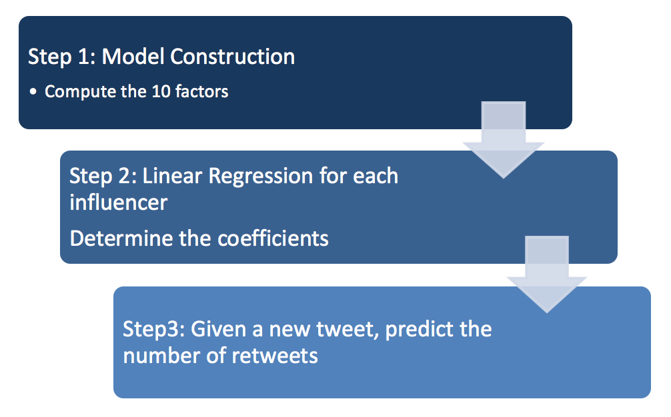
Framework
1

Slide 5
PART
2
Model Construction

Slide 6

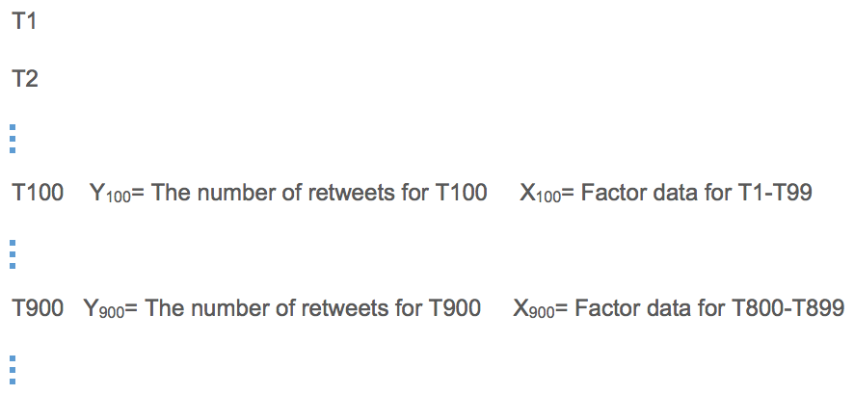

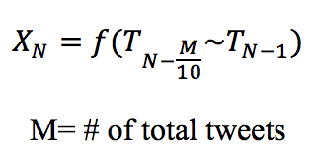
2
顶部“开始”面板中可以对字体、字号、颜色、行距等进行修改 Each Influencer
Notes:
Here we are using an example to explain the construction of our model.
Each user will have its own model.
Here we present a hypothetical user with 1000 tweets, labeled T₁ through T₁₀₀₀. These tweets are ordered based on their time stamps.
Our response variable Y_{N} will be the number of retweets of each tweet T_{N}.
The explanatory variable X_{N} will be a vector of the data relating to tweets T_{N-100} through T_{N-1} .
For example, the Y₁₀₀ is the number of retweets of T100. X₅₀₀ is the data about tweets T₄₀₀ through T₄₉₉.
Because our data consists of running averages, we will start with Y100 to avoid volatility in the running averages.
For each user, the first 10% of tweets will make up our first data point. The last data point for model construction will use the first 90% of tweets.
For our example here, that means our data consists of X₁₀₀ to X₉₀₀ . Using this data we will perform a linear regression to create the user’s model.

Slide 7
PART
3
Model Testing

Slide 8

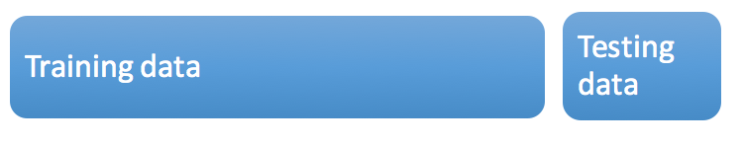


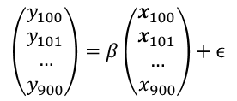
3
The predicted value
The true value
Calculate the mean square errors (MSE) to evaluate the model
点击此处添加标题
点击此处添加标题
Notes:
Once we have constructed a linear model for each user, we can use the last 10% of tweets for each user to test the models.
Continuing our previous example, we would use the X₉₀₁ through X₁₀₀₀ to create predicted values for₉₀₁ through ₁₀₀₀ . We then use our predicted and actual response values to calculate the mean square error.
Train the model based on T1-T900
Test the model’s predictive value on T901-T1000

Slide 9
PART
4
Choosing the influencer

Slide 10
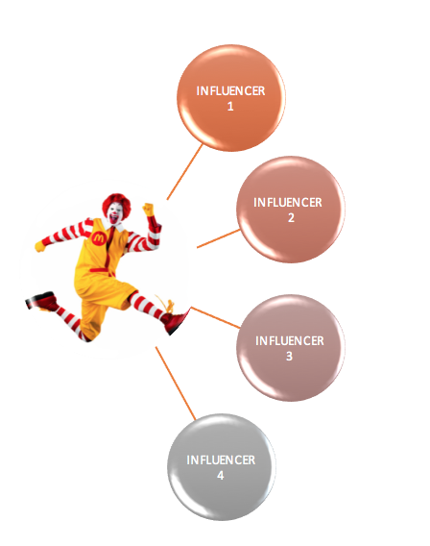
4
The number of retweets
The number of retweets
The number of retweets
The number of retweets
Notes:
Once we have constructed our model, we can input the data from the previous 10% of tweets to get a prediction of the number of retweets.

Slide 11
PART
5
Factors

Slide 12
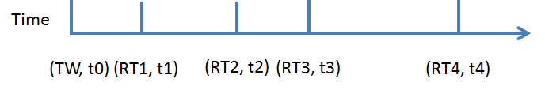
5
Number of Retweets
Focus of topics (# tweets with hashtags/ # hashtags)
Number of active followers
Words in common with the new tweet
Number of photos, videos, and gifs
Average duration
Average retweet time
Fraction of capital letters
Popular topics
Average number of words/tweet length
Notes:
1. If an influencer has had many retweets in the past, then we can assume that his future tweets wil have more retweets.
2. According to [3], users who focus their tweets on a single topic are more likely to gain more influence.
3. The tweets of someone with more active followers are more likely to be retweeted.
4. The influencer should be influential in the tweet’s field.
5. Tweets with different type of media will have different level of popularity.
6. The time between the last retweet and the original tweet. It measures how long a tweet is in circulation.
7. The average time between the original tweet and each of its retweets. This measures how quickly it spreads.
8. More capital letters might suggest that the message the user is trying to convey is more exciting or more important.
9. A user who frequently posts popular topics may be more influential.
10. A user who uses simpler or shorter words are more likely to be more influential.

Slide 13
PART
6
Reference:

Slide 14
6
Reference:
Rosenman, Evan TR. “Retweets—but not just retweets: Quantifying and predicting influence on twitter. Diss. Bachelor’s thesis, applied mathematics.” Harvard College, Cambridge, 2012.
Willis, Alistair, Ali Fisher, and Ilia Lvov. "Mapping networks of influence: Tracking Twitter conversations through time and space." Participations: Journal of Audience & Reception Studies 12.1 (2015): 494-530.
Cha, Meeyoung, et al. "Measuring User Influence in Twitter: The Million Follower Fallacy." ICWSM 10.10-17 (2010): 30
Bakshy, Eytan, et al. "Everyone's an influencer: quantifying influence on twitter." Proceedings of the fourth ACM international conference on Web search and data mining. ACM, 2011.
点击此处添加标题
点击此处添加标题

Slide 15
Tweety
THANK
YOU!

